Slide 1
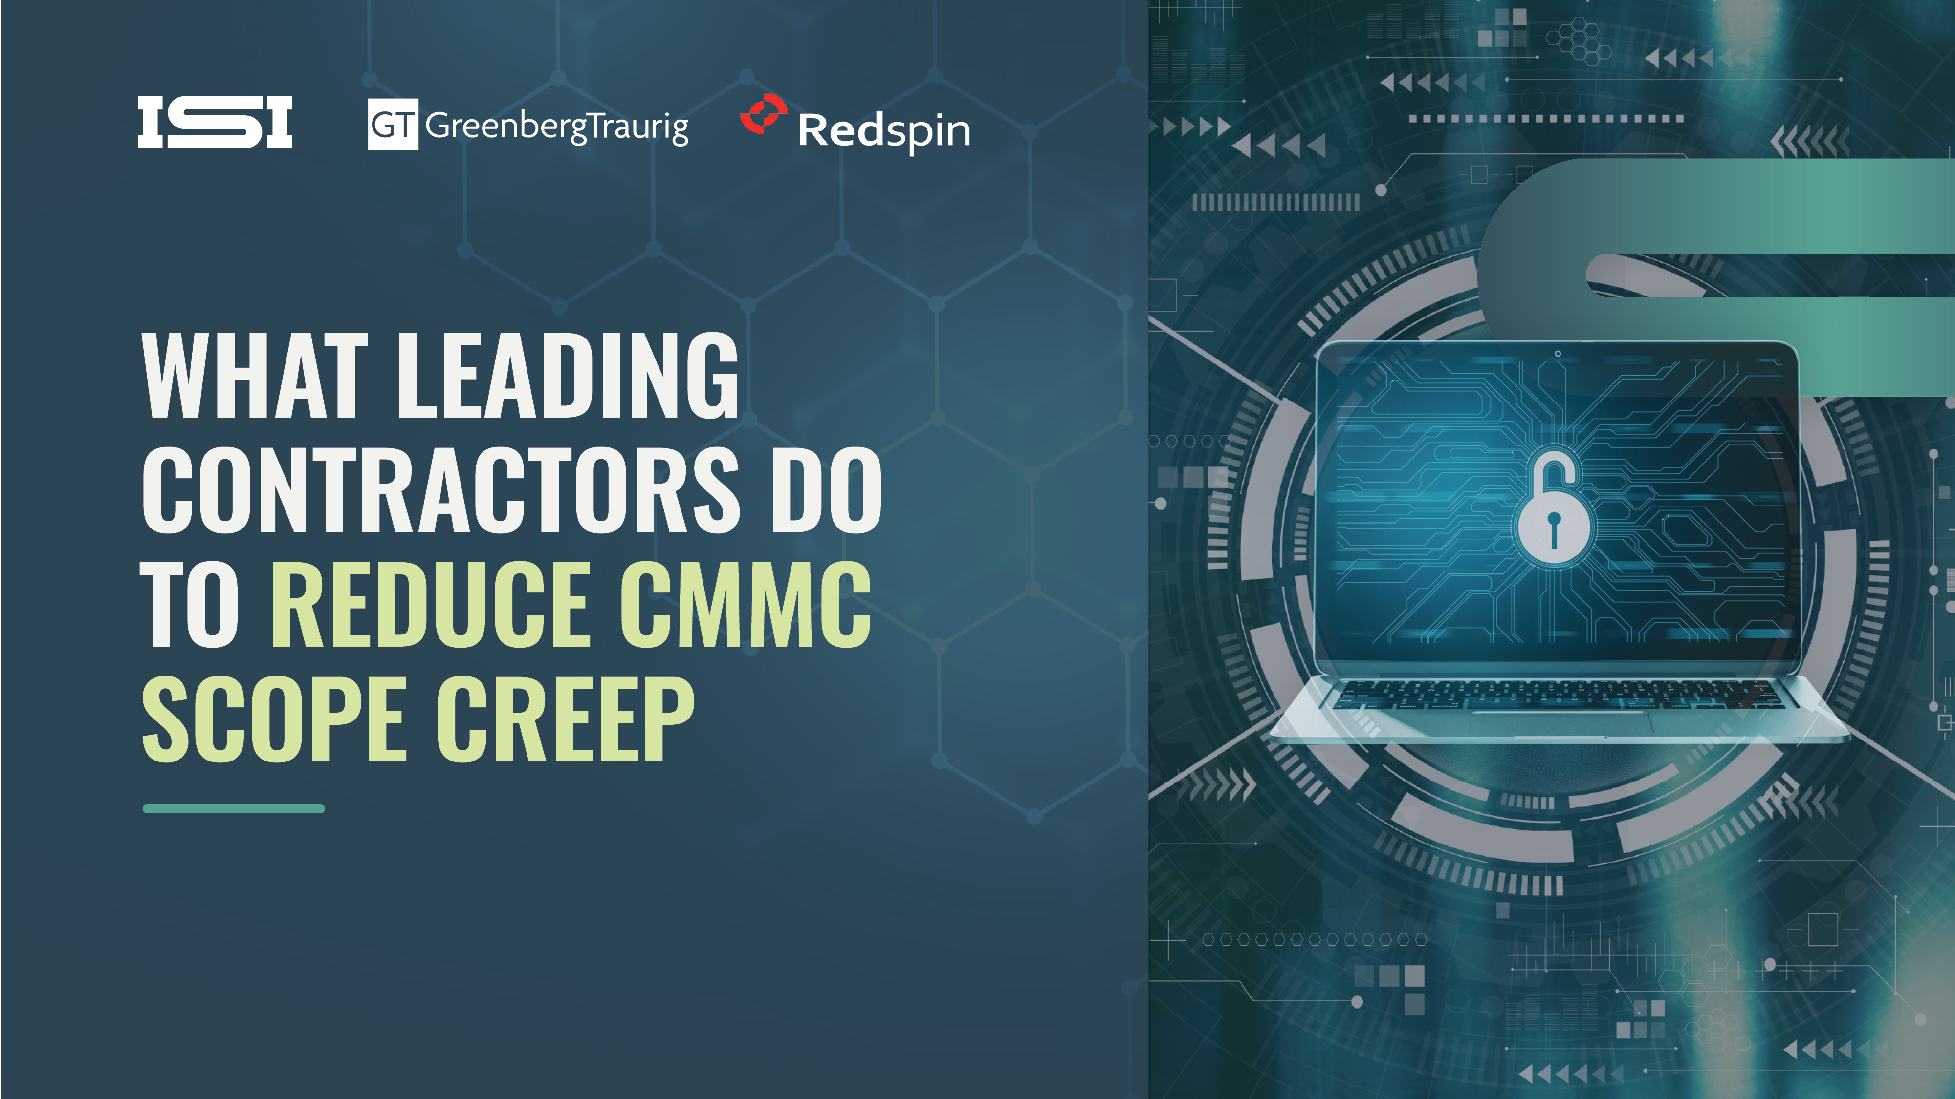

Slide 2



SPEAKERS
Eleanor Ross Associate
Greenberg Traurig
Robert Teague Vice President, Federal Consulting
Redspin
John Nolan Vice President, Compliance Services
ISI
Notes:
Eleanor from GT Law: https://isienterprises-my.sharepoint.com/:i:/g/personal/cvanpelt_dodsecurity_com/IQBcesKFvXplRYHoDNd3p-G3Ad6sgocgvFMumynOKpNLQZg?e=mNV0bT

Slide 3


AGENDA
01
CMMC Level Determination and Flow Down Reality
02
Scoping Decisions That Shape SSP Quality and Assessment Readiness
03
External Service Providers and Shared Responsibility Pitfalls
04
Enclaves and Boundary Design Tradeoffs
05
Life After Certification and the Cost of Early Decisions
06
Gray Areas, Timing, and Evolving Guidance
Notes:
Eleanor from GT Law: https://isienterprises-my.sharepoint.com/:i:/g/personal/cvanpelt_dodsecurity_com/IQBcesKFvXplRYHoDNd3p-G3Ad6sgocgvFMumynOKpNLQZg?e=mNV0bT

Slide 4


ASK QUESTIONS
PRESENTER RESOURCES
John Nolan jnolan@dodsecurity.com
Eleanor Ross Eleanor.Ross@gtlaw.com
Robert Teague robert.teague@redspin.com
Notes:
Eleanor from GT Law: https://isienterprises-my.sharepoint.com/:i:/g/personal/cvanpelt_dodsecurity_com/IQBcesKFvXplRYHoDNd3p-G3Ad6sgocgvFMumynOKpNLQZg?e=mNV0bT

